Slide 1
Asynchronous JavaScript and Event Loop
Concurrency, call stack and non blocking code
Notes:
`

Slide 2
Me
Technical Lead – Nagarro (Gurgaon)
medium.com/@tarunnagpal78
http://www.tarunnagpal.me
Twitter @tarunnagpal78

Slide 3
Why JavaScript So Popular !
Server Side JS (Node) can handle > 10000 concurrent request.
Client side libraries (angular/react) can write fast and non blocking code.
Widely Supported.
https://insights.stackoverflow.com/survey/2018#most-popular-technologies

Slide 4
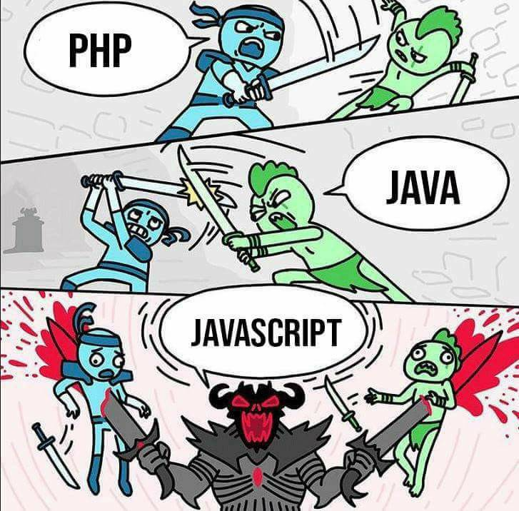

Slide 5
What makes it so powerful !!

Slide 7
Fundamentals

Slide 8
Call Stack
A data structure that uses the stack to temporarily store and manage function invocation (call).
A call stack is a mechanism for an interpreter to keep track of its place in a script that calls multiple functions.
It take care what function is currently being run, what functions are called from within that function and should be called next, etc.

Slide 9
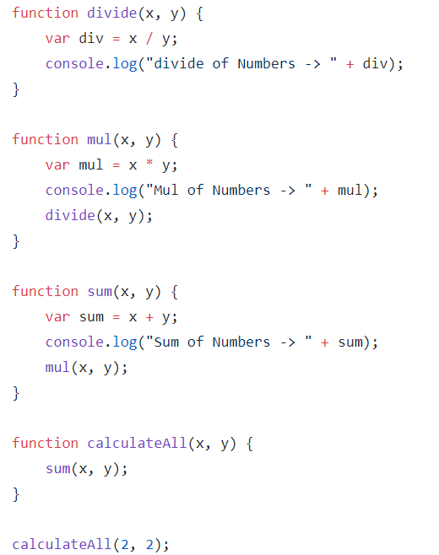
https://goo.gl/abyrVm
Divide()
Mul()
sum()
CalculateAll()
Main()

Slide 10
Blocking vs Non-Blocking Code

Slide 11
var getFirst = getFirstResponse();
var getSecond = getSecondResponse();
var getThird = getThirdResponse();
var getFourth = getFourthResponse();
console.log("Results are completed");
var getFirst = getAsynFirstResponse();
var getSecond = getAsynSecondResponse();
var getThird = getAsynThirdResponse();
var getFourth = getAsynFourthResponse();
console.log("Results are completed");

Slide 12


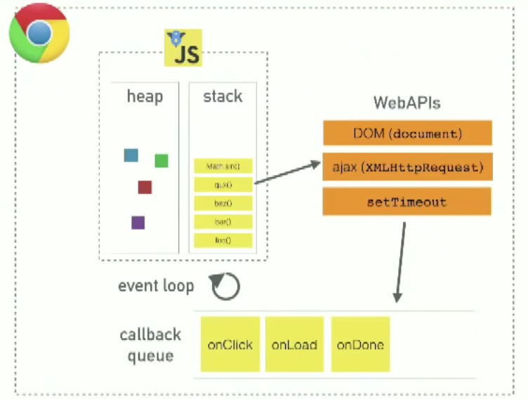




Slide 13
Examples (Time to play the game)
https://goo.gl/abyrVm - callStackDemo.js
https://goo.gl/KpPyMn - timeout.js
https://goo.gl/jse9Ns - timeout_01.js
https://goo.gl/L4Dfwi - asyncAndSyncCode.js
https://goo.gl/ou7Sbx - blowCallStack

Slide 14
Blowing the call stack
When the code execution takes stack beyond the capacity.
Range Error: Maximum call stack size exceeded.

Slide 15
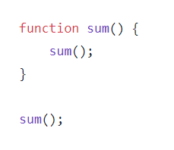
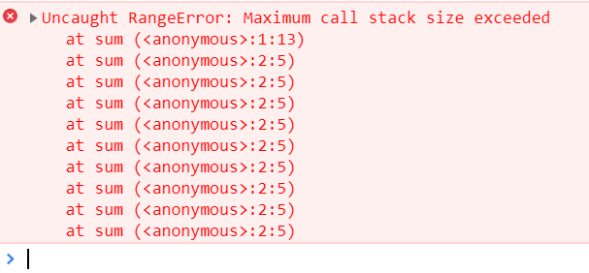
https://goo.gl/vuoKiE

Slide 16
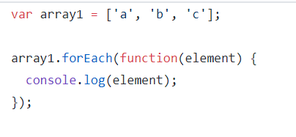
Synchronous IO
When the browser must halt the rendering
of the page in order to complete the execution of JavaScript code. it blocks the page from rendering until the code execution completes.
https://goo.gl/oD5m2x

Slide 17
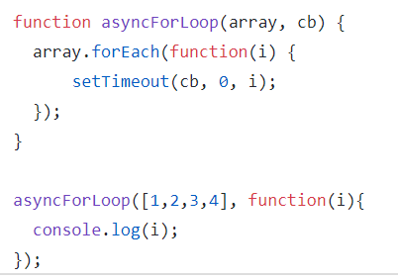
Asynchronous IO
JavaScript code is processed in parallel to the rest of the page content.
https://goo.gl/oD5m2x

Slide 18
Modern Async Techniques
Call-backs
Promises
RXJS (Observables)
Async Await
Generators

Slide 19
Takeaways
All JavaScript runtimes expose a single-threaded event loop
Build your system around events and asynchronous callbacks
Various runtimes provide additional tools for handling concurrency
Just one approach - there are many more!

Slide 20
Questions !!!

